Slide 1
Decode 11.1 Data Modelling and Machine Learning
CLASSIFICATION MODEL
HIMANSHU KUMAR(DS20DEC05)

Slide 2
Feature Engineering:
Net-Income:
Income level less than 50K is more than 3 times of those above 50K, indicating that the the dataset is somewhat skewed. However, since there is no data on the upper limit of adult's income above 50K, it's premature to conclude that the total amount of wealth are skewed towards high income group.

Slide 3
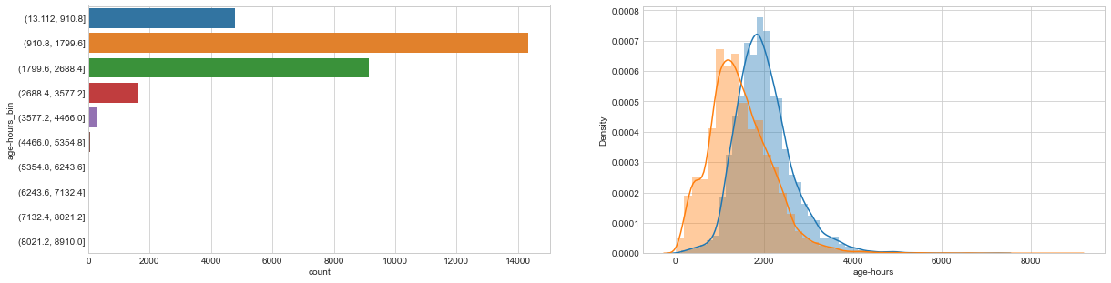

Age vs Income Level

Slide 4
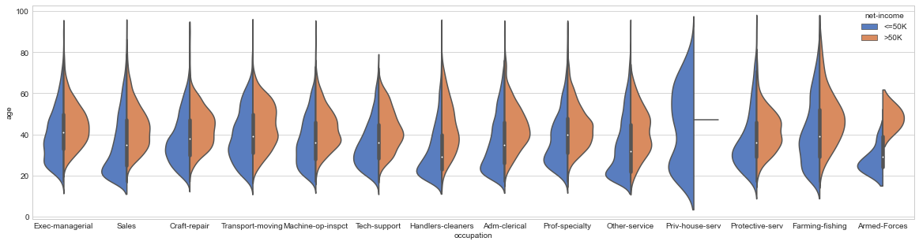
Occupation vs Income Level The general trend is in sync with common sense: more senior workers have higher salaries. Armed-forces don't have a high job salaries. Interestingly, private house service has the widest range of age variation, however, the payment is no higher than 50K, indicating that seniority doesn't give rise to a higher payment comparing to other jobs.

Slide 5
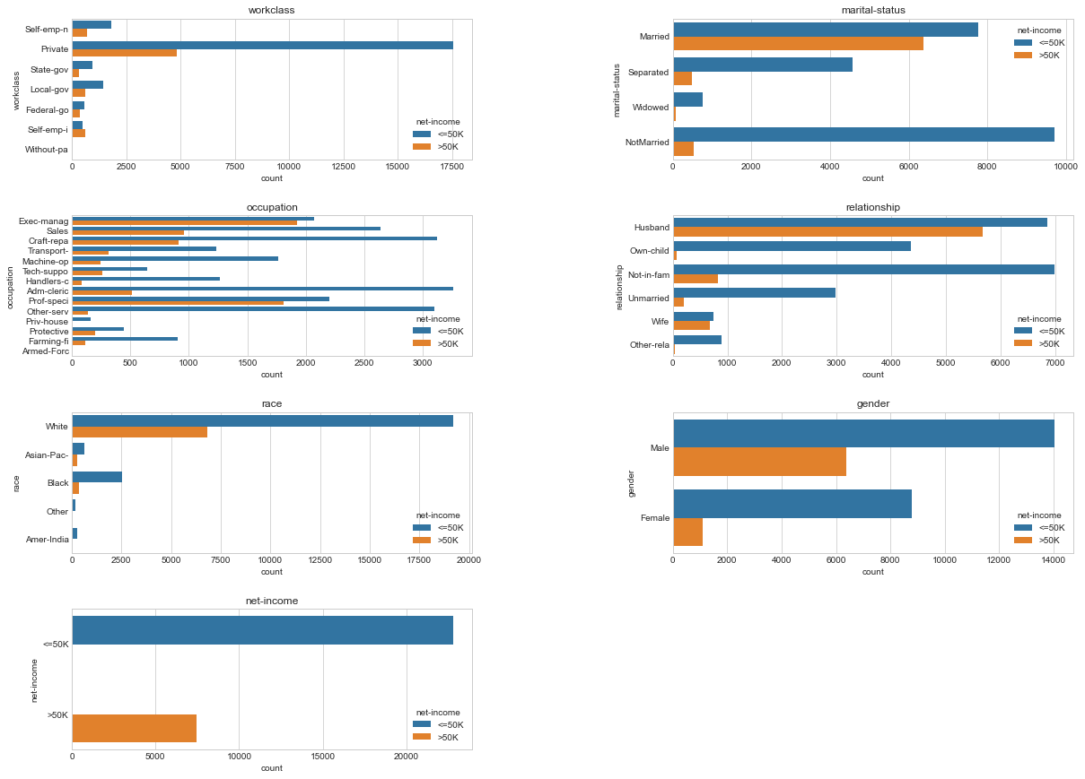
Bivariate Analysis:

Slide 6
Objective of the project: The goal of this machine learning project is to predict whether a person makes over 50K a year or not given their demographic variation. To achieve this, several classification techniques are explored and the Random forest model(83.47) yields to the best prediction result.
CLASSIFICATION MODEL

